Slide 1





OpenPilot
Conceptual Architecture

Slide 2

Table of contents
01
06
02
07
03
08
04
09
05
10
Introduction
How the System Evolves
Key Features
Control and Dataflow
How it Works
Concurrency in OpenPilot
High Level Architecture
Implications for Developers
Main Components
Conclusion

Slide 3



01
Introduction

Slide 4
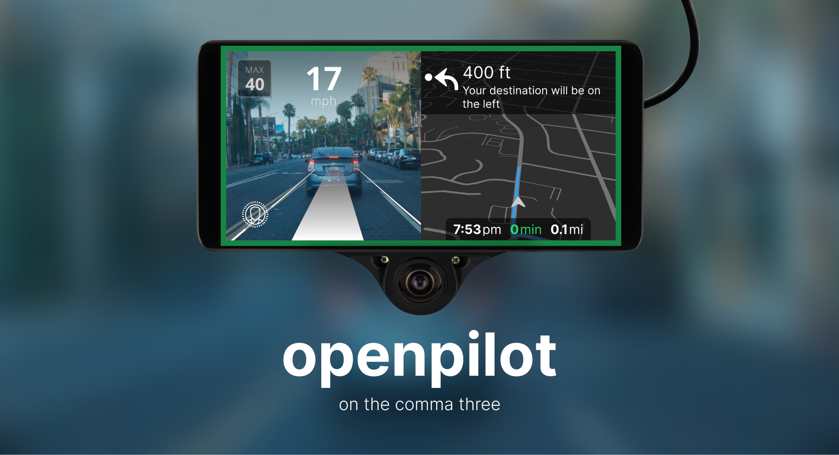
Introduction
What is OpenPilot?
An open-source driving assistant developed by Comma.AI
Enabling advanced features using machine learning to understand the road and how your car moves

Slide 5



Activate
OpenPilot Software
Monitor
Camera feed
Analyze Lane and calculate adjustments
Based on calculated data, adjust as necessary:
Speed
Vehicle Direction

Slide 6
02
Key Features

Slide 7
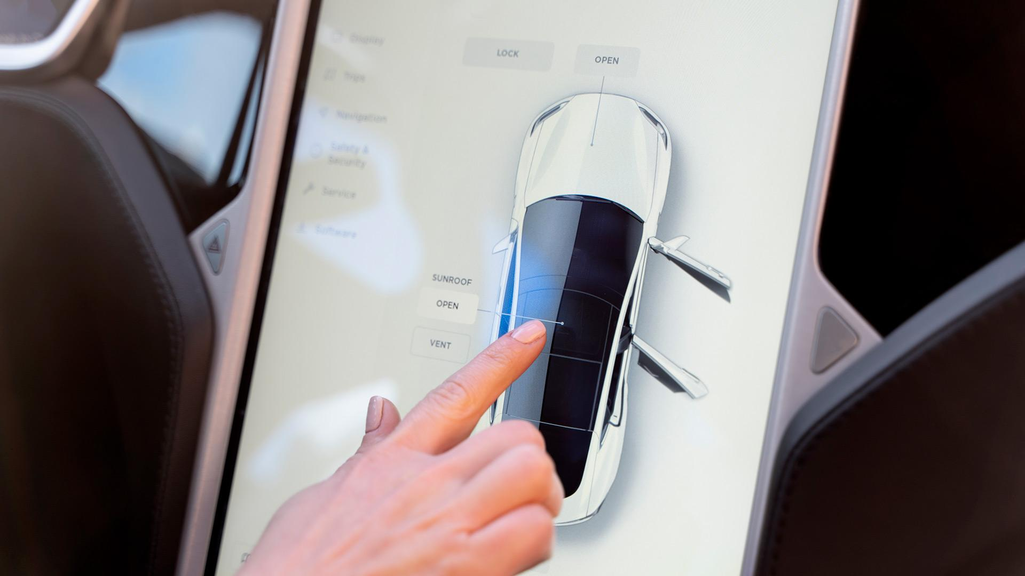

Key Features
Automated Lane Centering
Adaptive Cruise Control
Driver Monitoring
Lane Change Assist
Open Source with Continuous Software Updates

Slide 8
03
How it Works

Slide 9
How it Works
Sensors and cameras collect environment and driver data
Neural networks analyze for understanding and prediction
Planning services decide on steering, acceleration, and lane switching
Continuous action evaluation via sensors and cameras
Real-time model and decision adjustments

Slide 10
05
Main Components

Slide 11

Main Components
Sensors and Actuators Management Services
Controls
Radard
Plannerd
controlsd
Boardd
Camerad
sensord
Neural Network Runners
System, Logging, and Miscellaneous Services
modeld
dmonitoringmodeld
Dmonitoringd
Manager
Thermald
loggerd/logcatd/proclogd
Athenad
ui
Localization and Calibration Services
Ubloxd
Locationd
Calibrationd
paramsd

Slide 12
06
How Does the System Evolve

Slide 13

How Does the System Evolve
The development of OpenPilot’s driver assistance system has been largely driven by the following:
Community Contributions
Data Collection and Analysis
Machine Learning and AI
Software Updates

Slide 15
7
Control and Dataflow

Slide 16
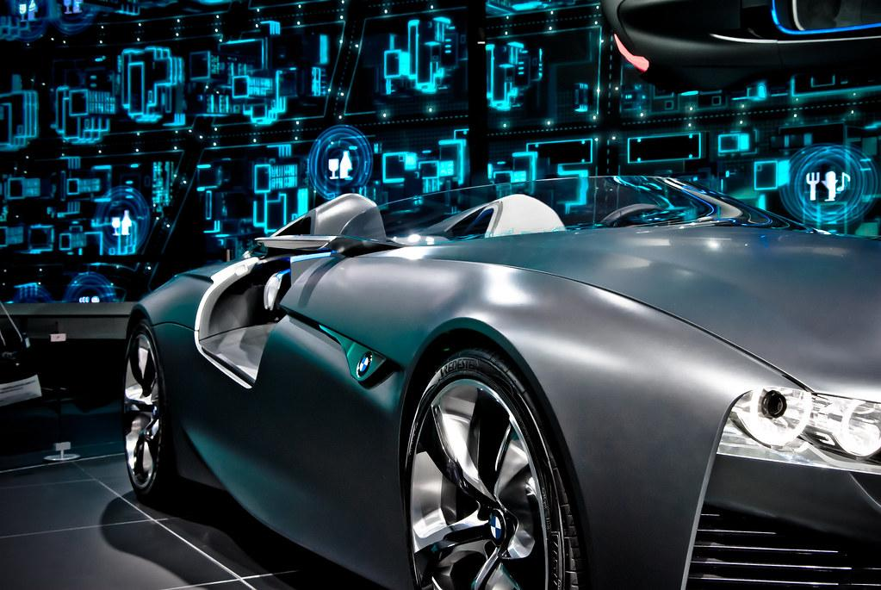
Control And Dataflow
Interplay between hardware and software enables OpenPilot to provide an advanced level of driver assistance
Sensors and Input Data
Data Processing and Decision Making
Actuation and Control
Feedback Loop
User Interaction:
Notes:
Is the sophisticated interplay between hardware and software which enables OpenPilot to provide an advanced level of driver assistance
Sensors and Input Data:
Integrates vehicle's built-in sensors with OpenPilot's cameras and sensors to gather comprehensive environmental data.
Data Processing and Decision Making:
Employs real-time processing with machine learning models on the Comma device to interpret sensory data, recognizing lane markings, vehicles, and road signs.
Actuation and Control:
Sends control signals via the vehicle's CAN bus for steering, acceleration, and braking based on algorithmic decisions.
Feedback Loop:
Monitors vehicle responses to refine actions in real-time, enhancing system accuracy and reliability.
User Interaction:
Features a user interface on the Comma device for system status, manual overrides, and customization options.

Slide 17
8
Concurrency In OpenPilot

Slide 18
Concurrency In OpenPilot
High-Frequency Task Handling:
Services like controlsd operate at specific frequencies (e.g., 100Hz) to meet real-time processing needs through concurrent execution.
Lateral and Longitudinal Planning:
controlsd and plannerd work concurrently on steering and gas/brake decisions, demonstrating task parallelism.
Sensor Data Processing:
Services such as boardd, camerad, and sensord handle various sensor inputs in parallel, showcasing concurrency in data handling.
Hardware Platform Support:
Compatibility with multiple hardware platforms (comma two, comma three, Linux PC) indicates design for concurrent hardware handling.
OpenPilot is designed with a concurrent architecture to allow many services to run in real-time, such as processing for sensors, decision making, and controls, all concurrently. This implementation assures fast reaction and effective execution through a publisher-subscriber model with communication between services and hardware platforms differing.
Inter-Process Messaging:
Utilizes a single publisher, multiple subscriber system for inter-service communication, enabling concurrent service operation.
Parallelized Service Execution:
Various services for sensors, neural network processing, localization, calibration, controls, and more, run concurrently for efficient task handling.
Service Interaction:
Data processing and decision-making involve multiple services working together, using concurrent processing to ensure real-time responsiveness.

Slide 19
Key ideas in market opportunity
Research new markets
Innovative solutions
Analyze existing customer needs and identify gaps in the market to find
new opportunities
Utilize technology and customer feedback to come up with novel solutions that meet your customer’s demands or needs
Stay ahead of trends
Seasonal spikes
Monitor changes in the marketplace, such as shifts in consumer behavior or emerging technologies, to stay competitive and capitalize on new opportunities and trends
Identify times of year when demand for certain products may spike, such as holidays or special occasions, and use these times to target customers or maximize sales

Slide 20
Six recommendations
Keep it simple
Use visuals
Keep it short
Structure your pitch deck clearly and make sure all the important points are easy to understand
Incorporate visuals or graphics to illustrate your message and keep the audience engaged
A good pitch deck should be concise and clear; avoid trying to cram in too much information
Make it memorable
Test & iterate
Main points
Include impactful stories, statistics, or facts that will help your audience remember your
message afterwards
Practice presenting your deck beforehand with friends or colleagues for feedback, then use this input to refine it further
A pitch deck is an overview of your business; focus on key points that get the most important ideas across

Slide 21

333,000
386,000 km
9h 55m 23s
Users bought our product
Avg. distance travelled by logistics team
Estimated delivery time per unit

Slide 22


8,300,000
Number of users analyzed in our market research

Slide 23
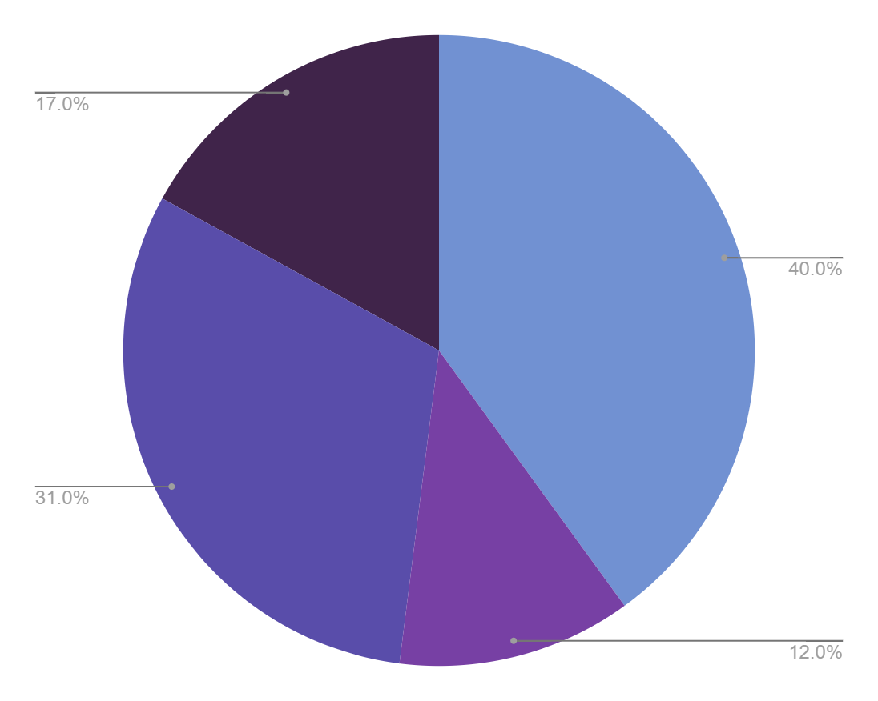
Revenue by quarter
Q1
Q3
January - March
July - September
Q2
Q4
April - June
October - December
Follow the link in the graph to modify its data and then paste the new one here. For more info, click here

Slide 24
Competition comparison
 | Features | Value | Pricing | Trial | Competence | Share
Company A | Fuel economy | Special offers | $23,000 | No | Low | 8%
Company B | Design | Reliability | $27,000 | No | Low | 5%
Company C | Performance | Repairs | $30,000 | Yes | High | 20%
Company D | Safety features | Marketing | $24,000 | No | High | 22%
Company E | Technology | Customers | $32,000 | Yes | Low | 10%
Company F | Comfort | Best prices | $15,000 | Yes | High | 30%
Company G | Customization | Brand name | $45,000 | No | Low | 5%

Slide 25
Timeline of your presentation
01
02
03
04
05
06
07
08
Provide a brief overview of the pitch deck's content
Engage the audience with a compelling introduction
Identify the customer's pain points
and challenges
Describe how your product or service can solve the problem
Highlight the unique value proposition and benefits of your specific solution
Analyze the target market size, growth potential, and competition briefly
Explain your financial needs and briefly outline your
funding allocation
End with a clear and concise call to action

Slide 26
Organizational chart
Sun
Ceo
Saturn
Sales Manager
Jupiter
Project Manager
Moon
Administration
Earth
Sales
Venus
Director
Mars
Assistant
Mercury
Secretary
Neptune
Employee
Ceres
Employee
Neptune
Employee
Ceres
Employee

Slide 27
Market size overview
$110m
Include the total size of the market, which represents the entire potential customer base for the product or service
$25m
Identify the target market for the product or service, which may be a subset of the total market. This could be based on factors such as demographics, geography, or specific needs
$6m
Indicate the current market size, which represents the portion of the target market that the company has successfully captured

Slide 28
Roadmap infographic
Initiative | Objective | 1 | 2 | 3 | 4 | 5 | 6 | 7 | 8 | 9 | 10 | 11 | 12
Understanding | Analyze and understand the needs of your target audience
Conduct research | Research existing products in the industry and analyze how successful they are
Brainstorm ideas | Generate ideas based on user feedback and research findings
Develop a prototype | Create a basic version of the product to show investors
Test for usability | Put the prototype through rigorous testing processes to ensure that it meets user requirements
Analyze feedback | Analyze feedback

Slide 29
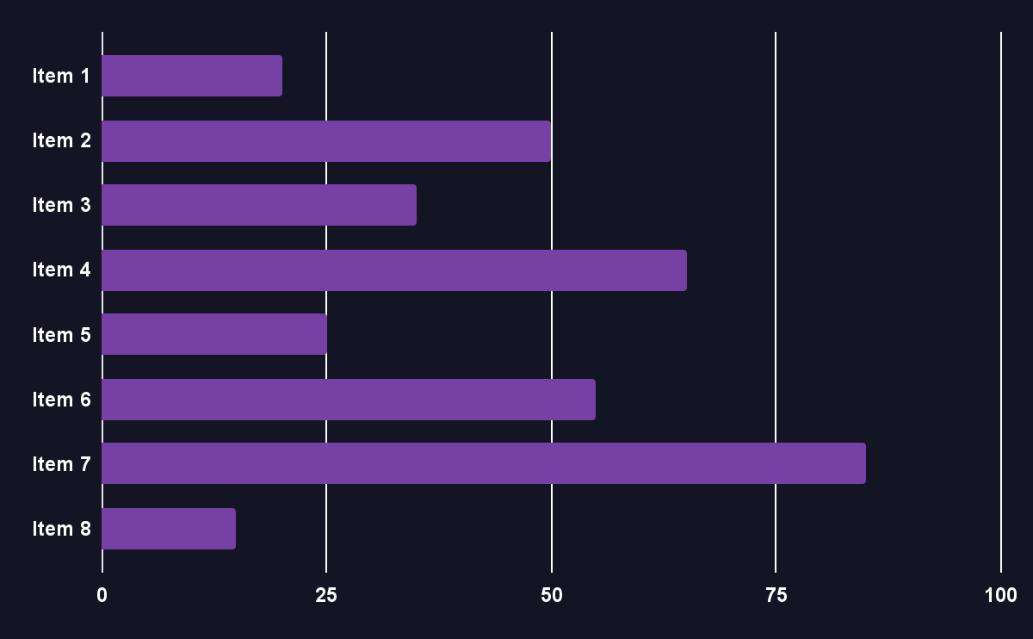
KPI dashboard
$4,000,000
$100,000
$5,000
Product | Units | Revenue | Returns
Item 1 | 500 | 2,000,000 | 40
Item 2 | 1,000 | 50,750 | 10
Item 3 | 250 | 1,500,000 | 300
Item 4 | 500 | 2,000,000 | 40
Item 5 | 1,000 | 50,750 | 10
Item 6 | 250 | 1,500,000 | 300
Item 7 | 500 | 2,000,000 | 40
Item 8 | 1,000 | 50,750 | 10
Revenue
General costs
Profit
Follow the link in the graph to modify its data and then paste the new one here. For more info, click here

Slide 30

Thanks!
Do you have any questions?
youremail@freepik.com
+34 654 321 432
yourwebsite.com

Slide 31
Fonts & colors used
This presentation has been made using the following fonts:
Fira Sans Extra Condensed
(https://fonts.google.com/specimen/Sora)
Roboto Slab
(https://fonts.google.com/specimen/Manrope)
#ffffff
#131524
#f47065
#fbcac4
#7191d2
#594daa
#1c2548
#7740a4
#754289
#40244a

Slide 32
Use our editable graphic resources...
You can easily resize these resources without losing quality. To change the color, just ungroup the resource and click on the object you want to change. Then, click on the paint bucket and select the color you want. Group the resource again when you’re done. You can also look for more infographics on Slidesgo.

Slide 35
JANUARY
FEBRUARY
MARCH
APRIL
MAY
JUNE
PHASE 1
Task 1
Task 2
PHASE 2
Task 1
Task 2
JANUARY
FEBRUARY
MARCH
APRIL
PHASE 1
Task 1
Task 2

Slide 38
...and our sets of editable icons
You can resize these icons without losing quality.
You can change the stroke and fill color; just select the icon and click on the paint bucket/pen.
In Google Slides, you can also use Flaticon’s extension, allowing you to customize and add even more icons.

Slide 39
Educational Icons
Medical Icons

Slide 40
Business Icons
Teamwork Icons

Slide 41
Help & Support Icons
Avatar Icons

Slide 42
Creative Process Icons
Performing Arts Icons

Slide 43
Nature Icons

Slide 44
SEO & Marketing Icons

Slide 45


